Slide 1
Port of Long Beach
Capital Improvement Projects
Allison Yoh, Ph.D.
Director of Transportation Planning
Port of Long Beach
FuturePorts June 28, 2018

Slide 2
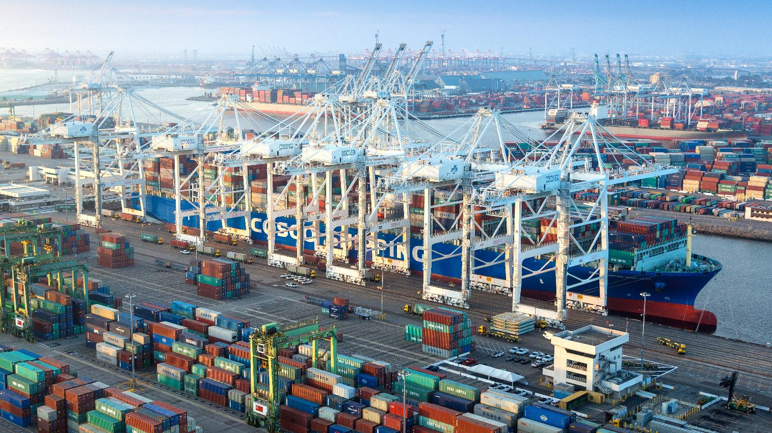
PORT OF LONG BEACH
Leading Gateway for U.S.-Asia Trade

Slide 3
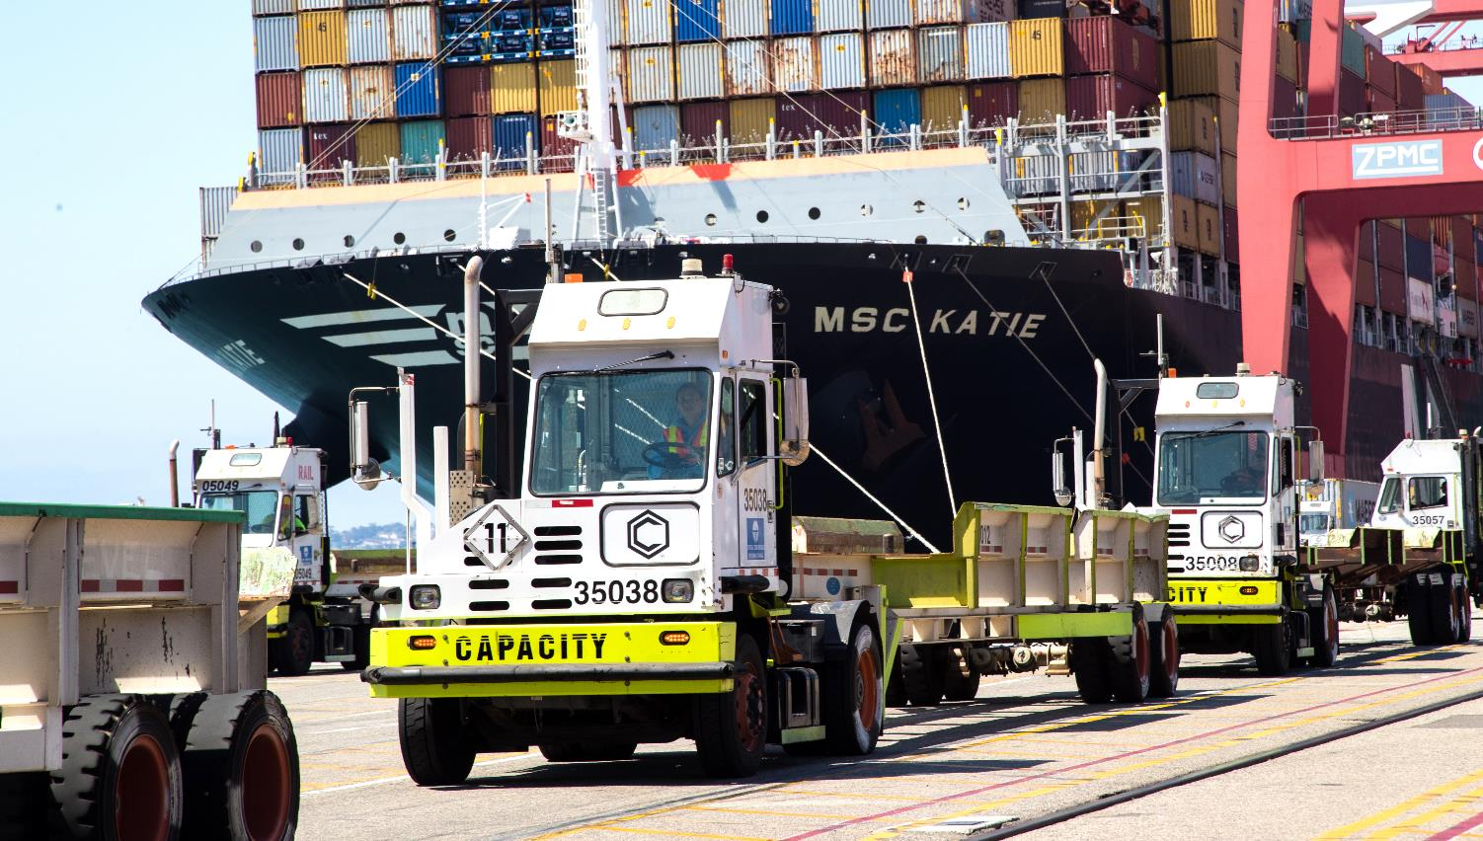
MAJOR ECONOMIC ENGINE
$Billions in Trade, Thousands of Jobs

Slide 4
$4 BILLION
CAPITAL PROGRAM

Slide 5
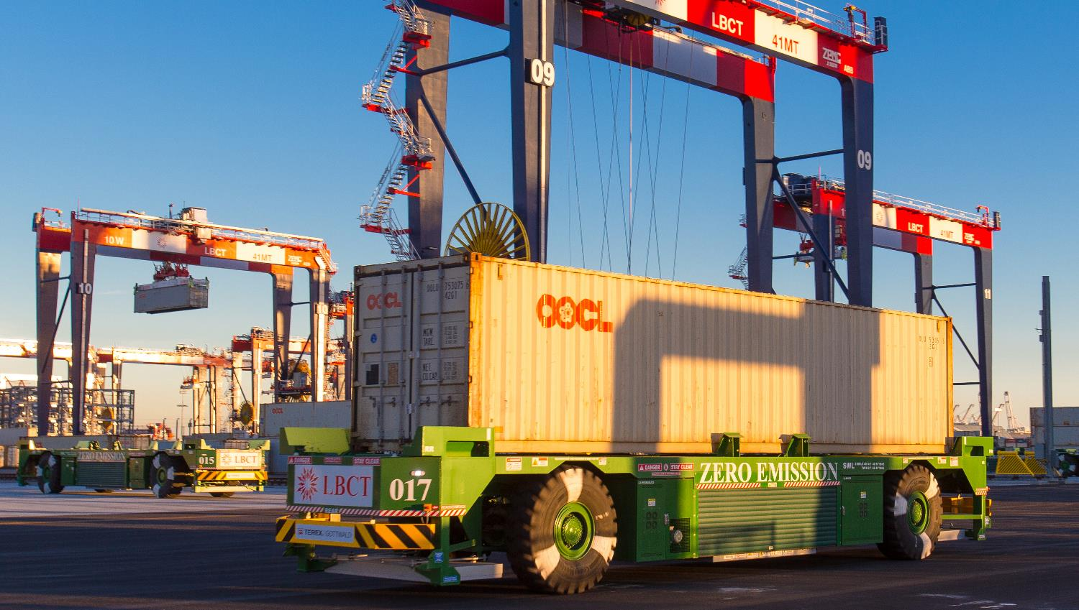
LONG BEACH CONTAINER TERMINAL
State-of-the-Art, Greenest

Slide 6
= 10 FOOTBALL FIELDS!
FINAL PHASE –
Under construction

Slide 7
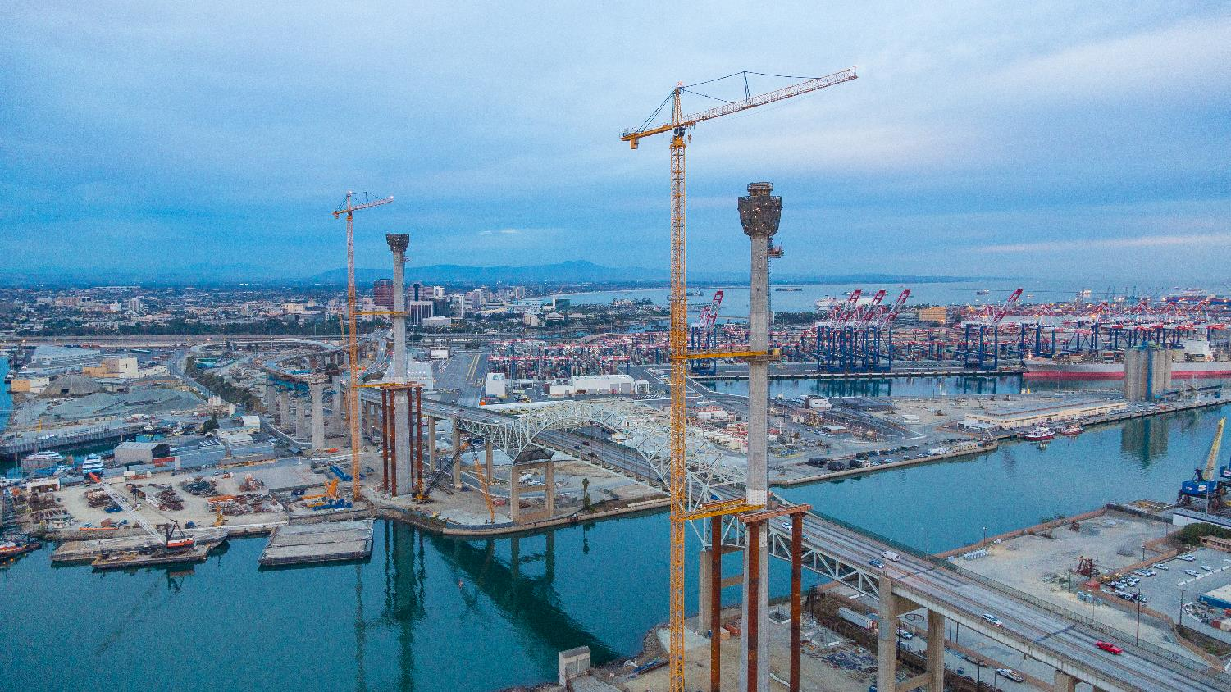
BRIDGE TO EVERYWHERE
$1.5 billion Project

Slide 8
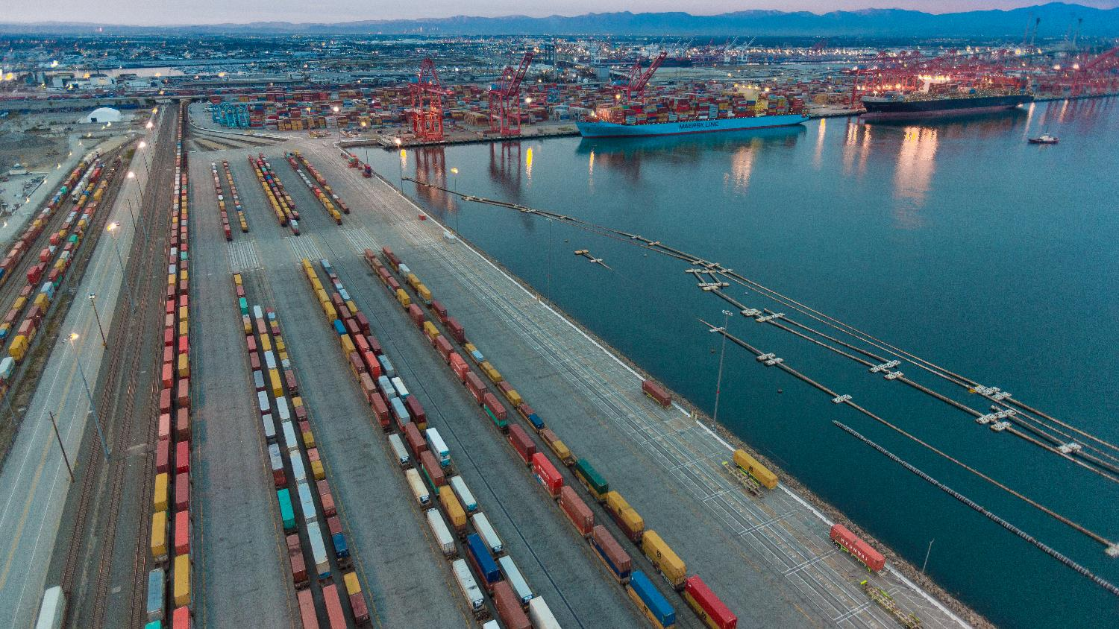
$1 BILLION
Investment in Rail Improvements

Slide 9
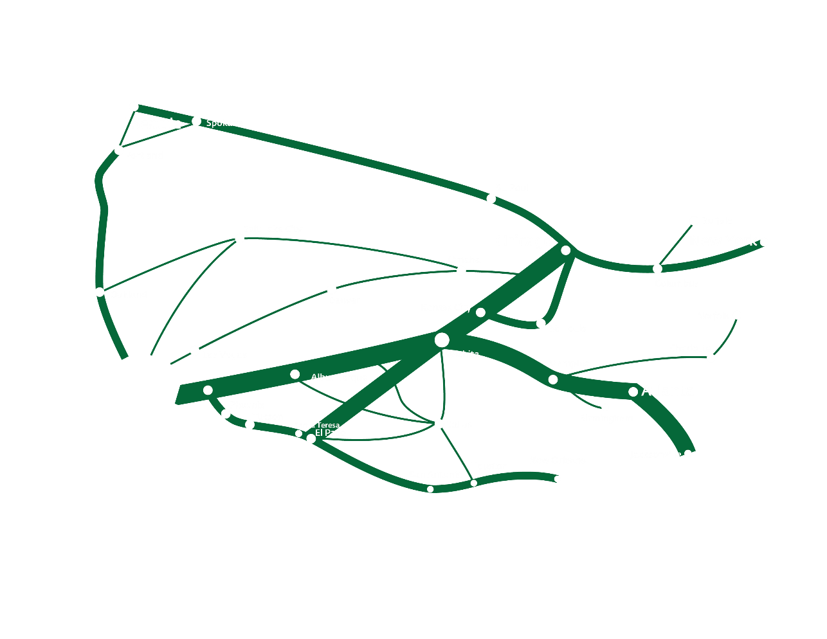
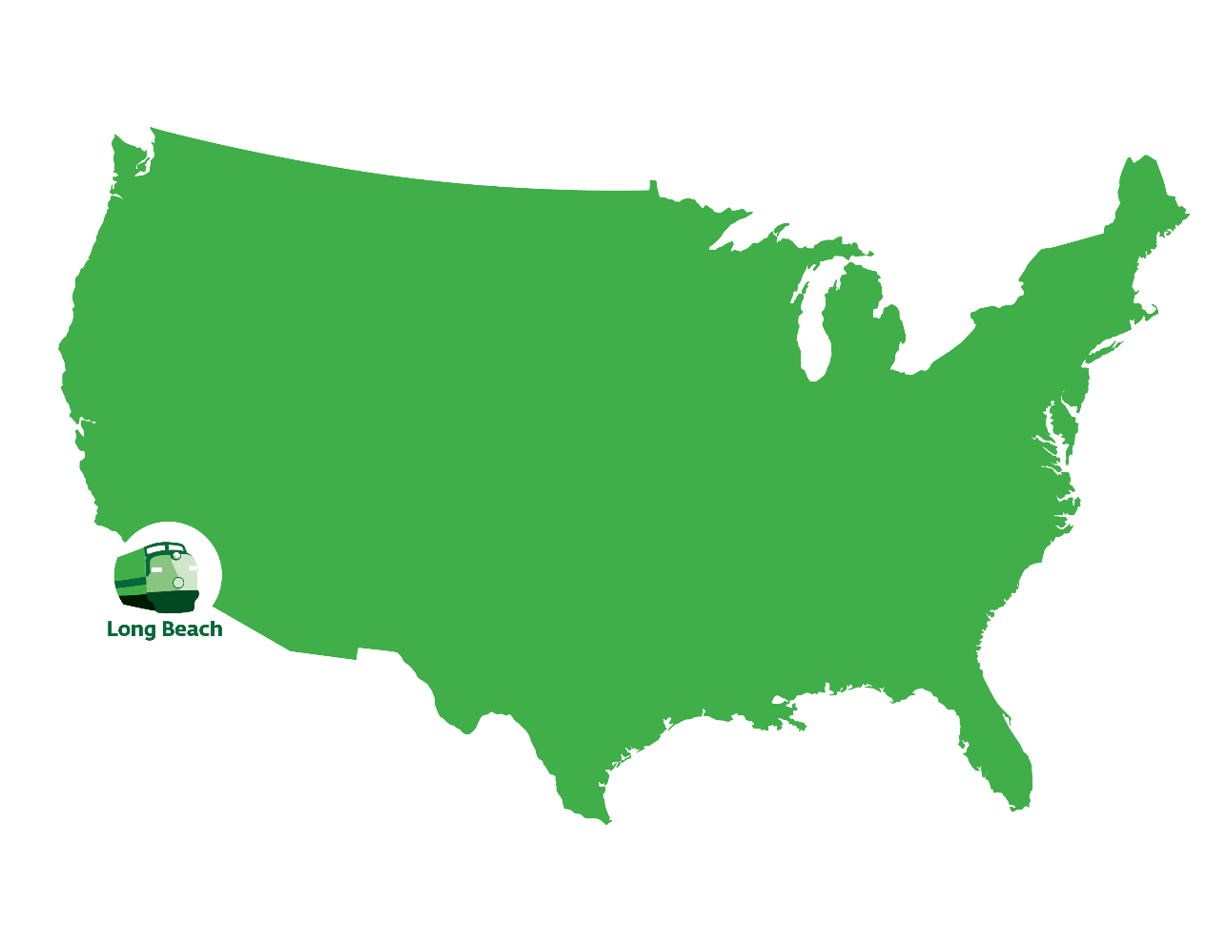

Slide 10
PIER B ON-DOCK RAIL SUPPORT FACILITY

Slide 11
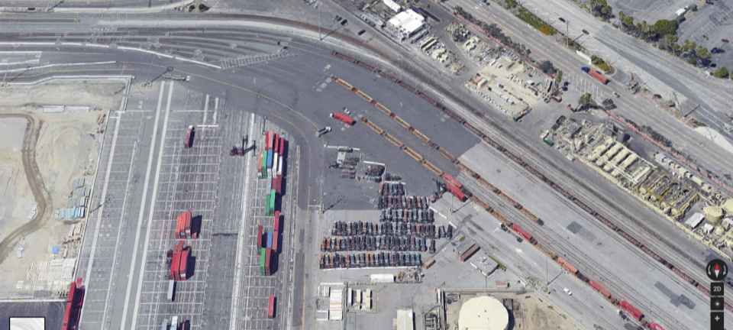
PIER G/J
DOUBLE TRACK ACCESS

Slide 12
Allison Yoh, Ph.d.
Director of Transportation Planning

