Slide 1
PROJECT UPDATE Southern California Project Sections Bakersfield to Palmdale Palmdale to Burbank Burbank to Los Angeles Los Angeles to Anaheim
October 2018

Slide 2
AGENDA
California High-Speed Rail Program
Project Section Highlights
Project Development / Route Selection Process
Next Steps

Slide 3
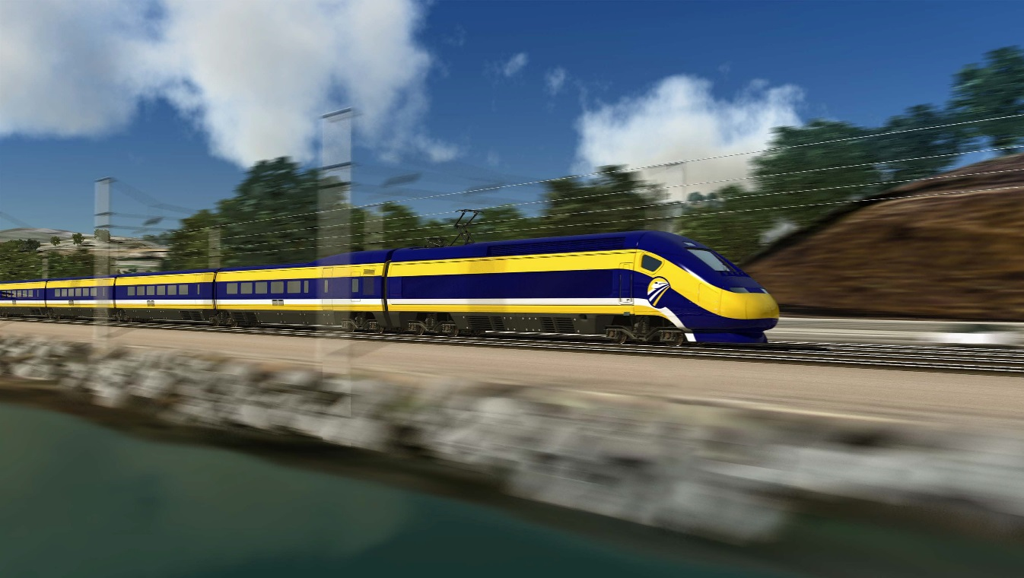
CALIFORNIA HIGH-SPEED RAIL Program

Slide 4
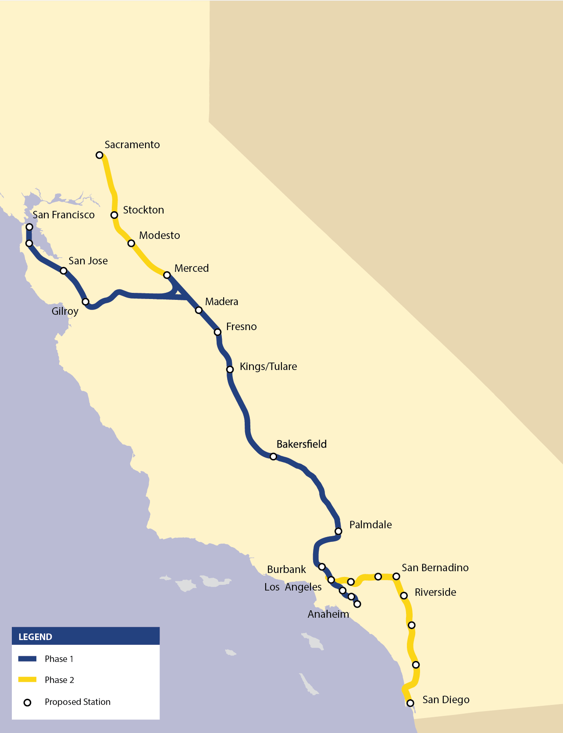
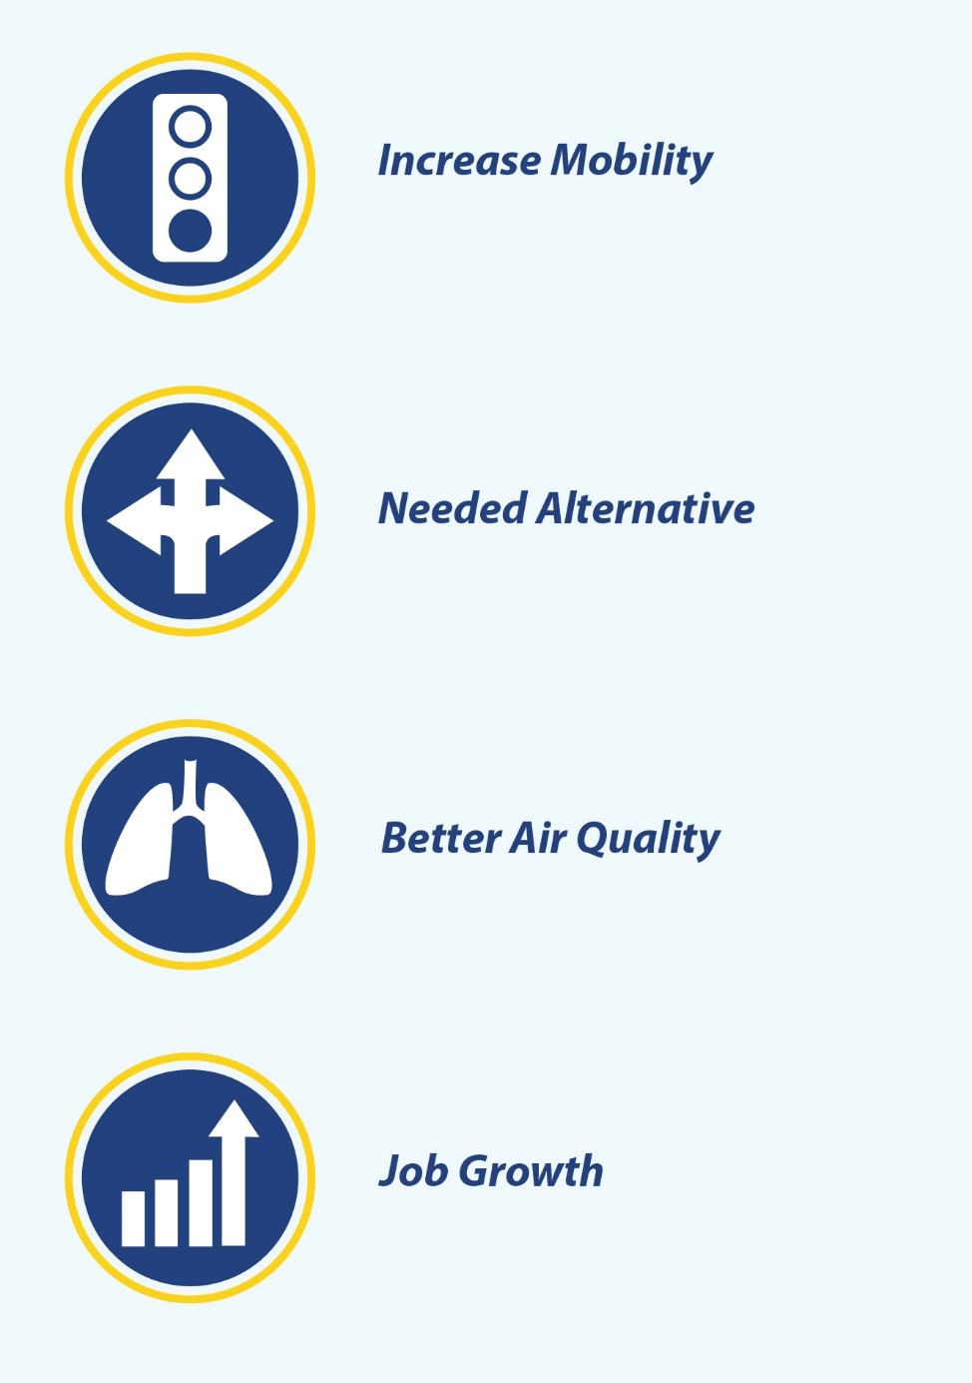
HIGH-SPEED RAIL: Connecting California

Slide 5
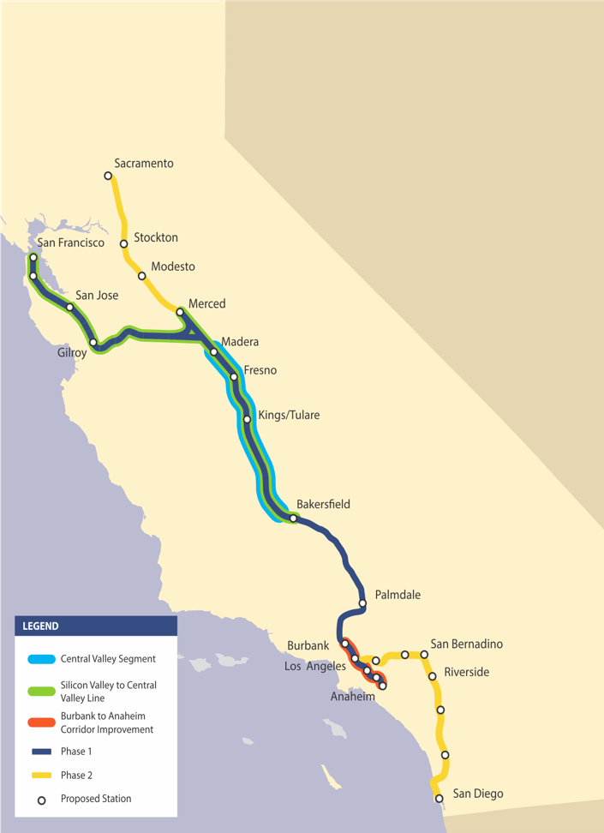
SOUTHERN CALIFORNIA: Meeting Our Commitments
Begin service on the Silicon to Central Valley Line
Complete Phase 1 route selection and environmental documents
Invest bookend funds as full partner in the Burbank – LA – Anaheim corridor
45-mile corridor with statewide significance
Investing $500 million in bookend funds as full partner in this shared corridor
$76 million – Rosecrans/Marquardt Grade Separation Project
Remaining $423 million to Los Angeles Union Station (Link US Project)
$18 million already approved for Link US for engineering/design
Begin service on Phase 1

Slide 6
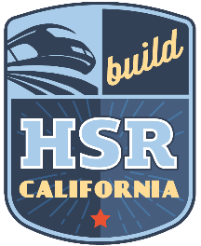
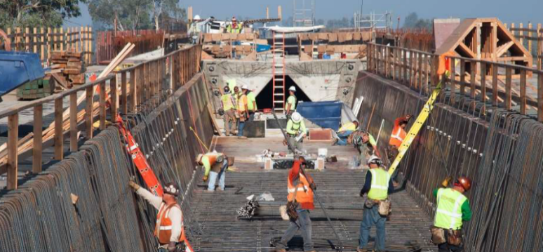
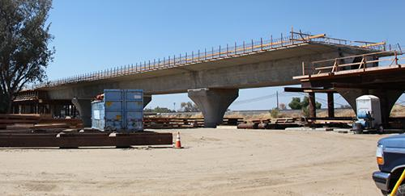
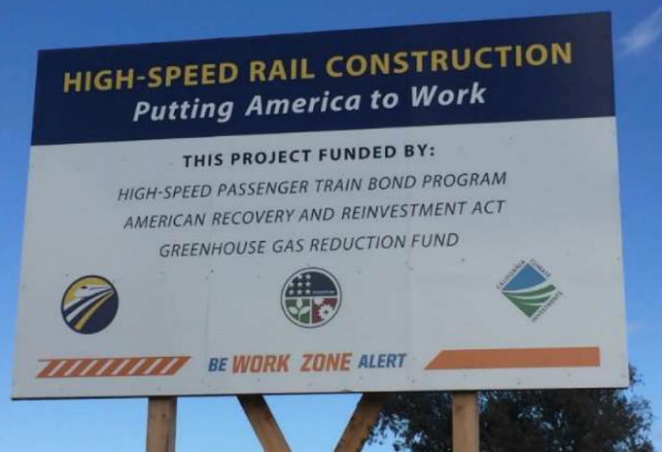
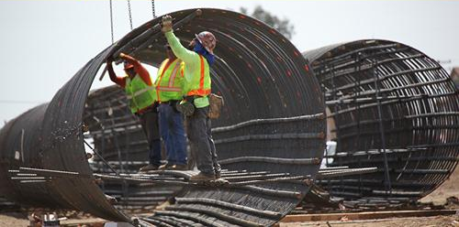
IT’S HAPPENING!
Approximately 119 miles
Approximately $3 Billion Investment
21 Active Construction Sites
2,300 + Jobs and Counting

Slide 7
Dedicated High Speed Rail BAKERSFIELD TO PALMDALE
Palmdale to Burbank
PROJECT SECTIONs

Slide 8
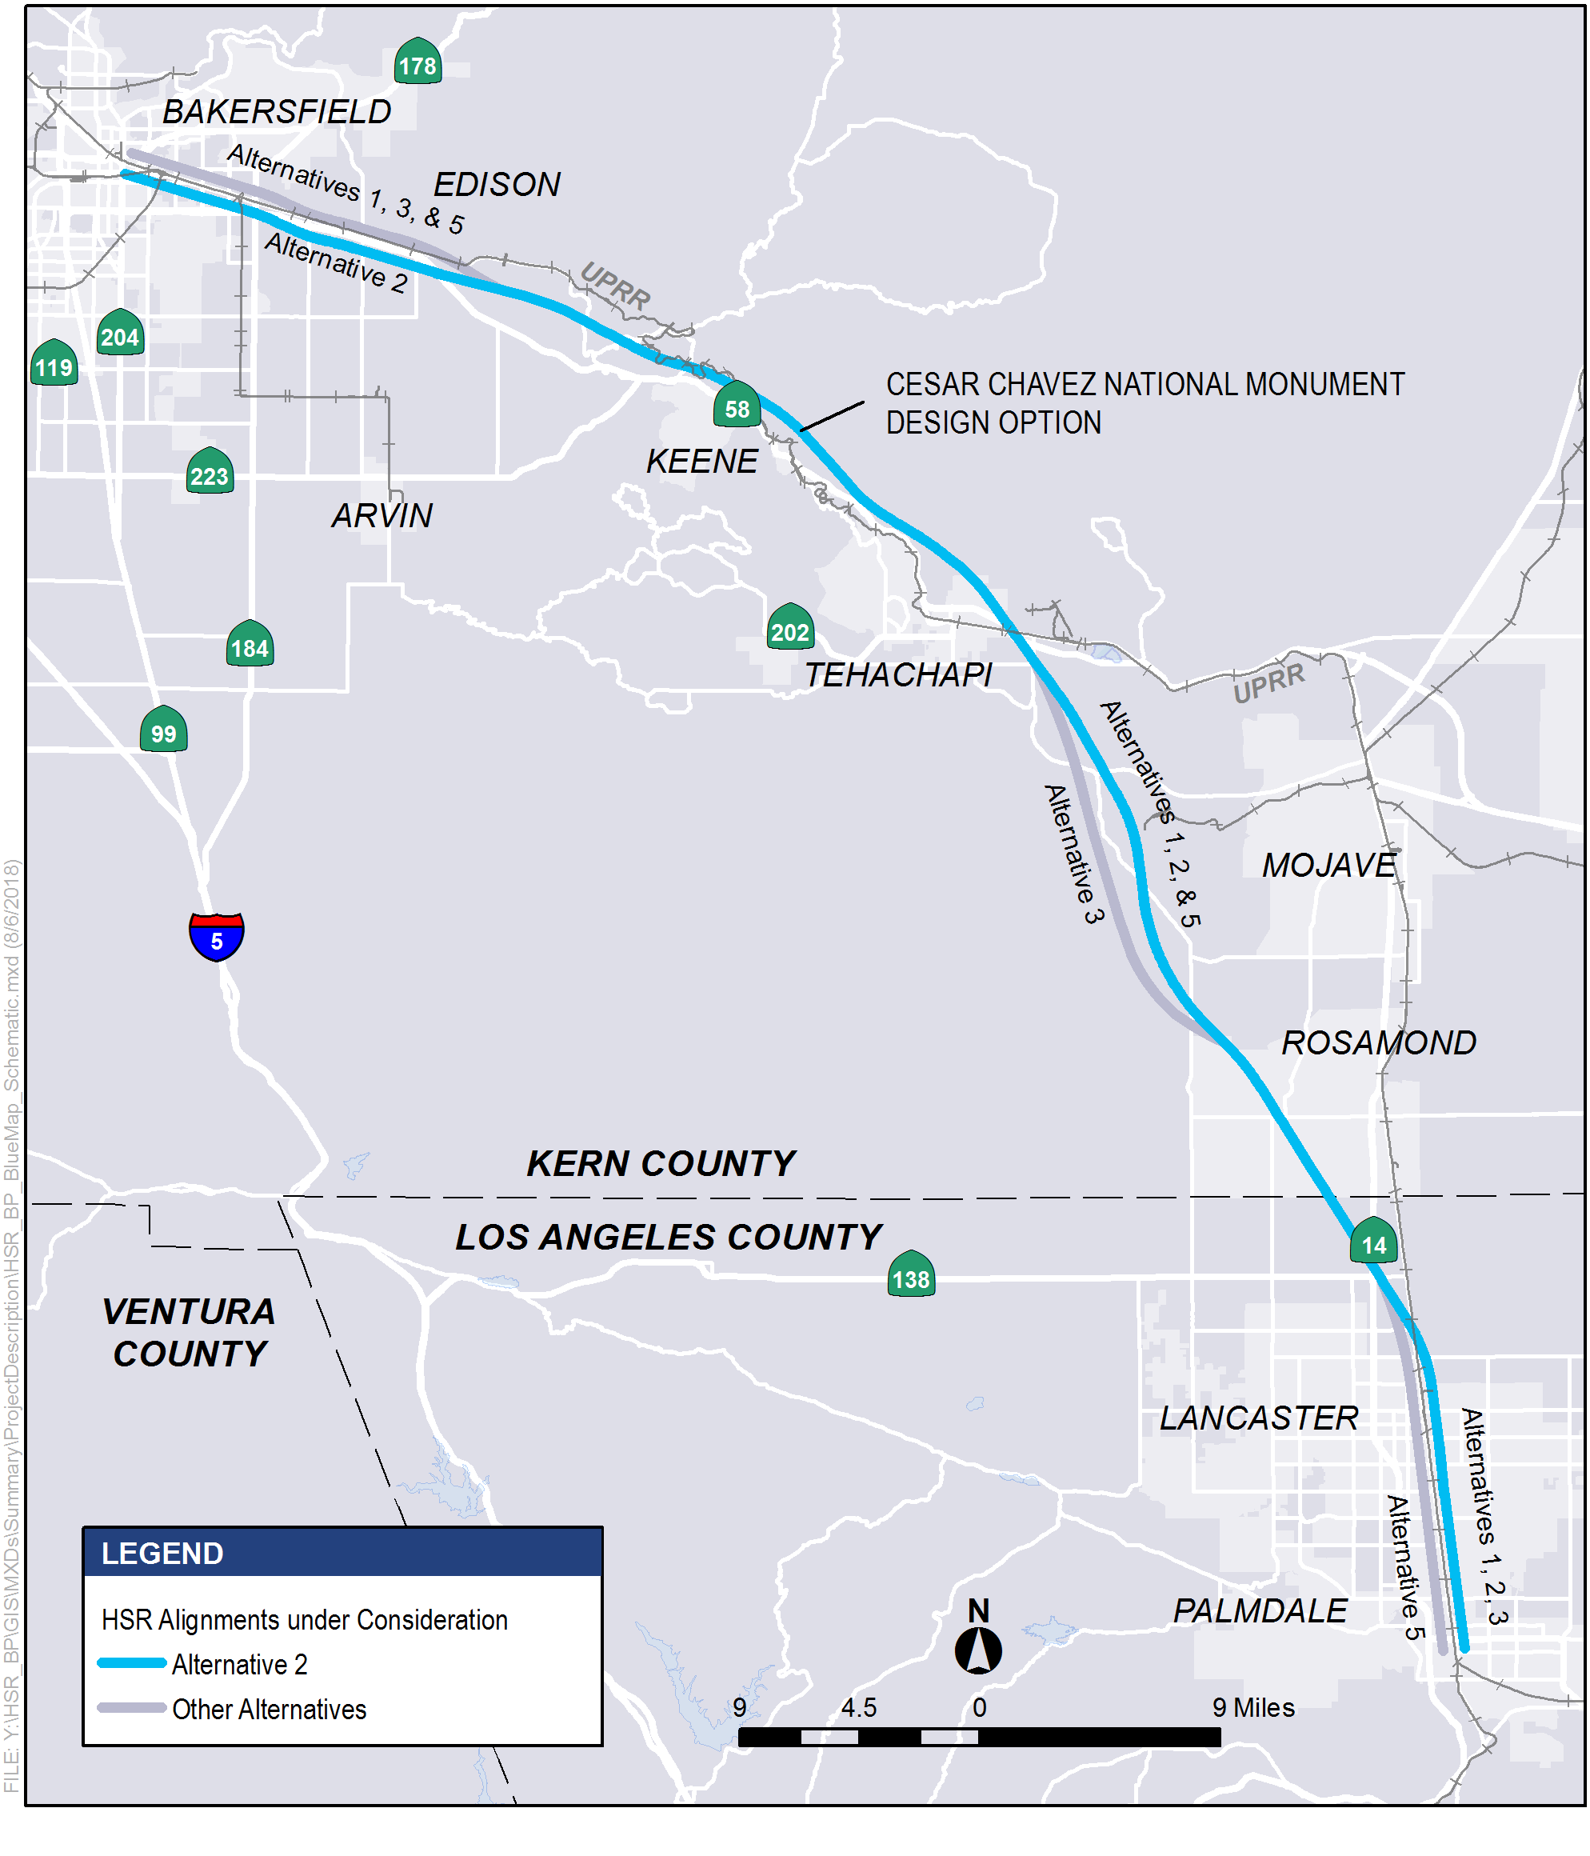
Bakersfield to Palmdale
Studied alternatives 1, 2, 3 & 5
Features of Alternative 2:
Two Stations
Bakersfield (Central Valley)
Palmdale (Antelope Valley)
Description
Does not require relocation of SR 58
Includes CCNM Design Option
Has fewer miles of tunnel construction
Consolidates multiple rail lines into one corridor in Lancaster
Results in fewer potential impacts to residents, businesses, community resources and the environment

Slide 9
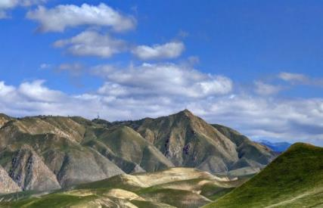
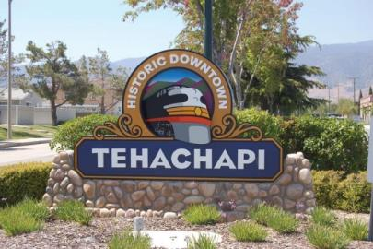
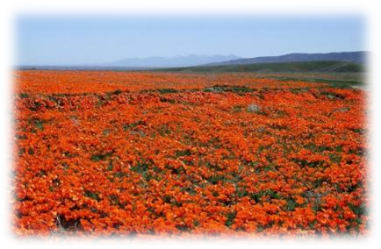
KEY AVOIDANCE & MINIMIZATION ACCOMPLISHMENTS
Edison – Avoid impacts to agricultural processing operations along Edison Highway
Keene – Reduce noise and visual impacts to Cesar Chavez National Monument
Tehachapi – Minimize impacts to natural resources and existing conservation areas lands
Lancaster – Address safety issues involved with existing at-grade rail crossings by grade-separating HSR, Metrolink, and UPRR with all major roadway intersections in the city
Palmdale– Avoid impacts to Plant 42 and the Palmdale Airport
Bakersfield and Palmdale Stations – Maximize ridership, take advantage of local land use planning and provide multi-modal transportation options

Slide 10
PALMDALE TO BURBANK PROJECT SECTION

Slide 11
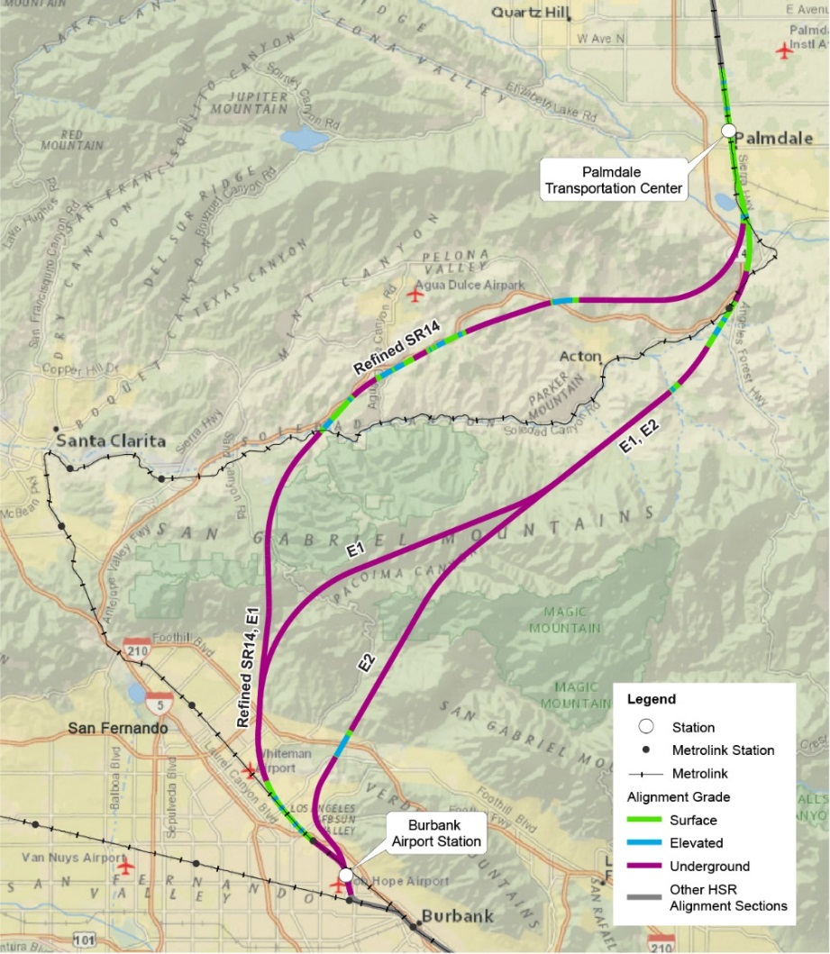
Palmdale to Burbank
Approximately 38 miles
Approximately 25 miles of underground bored tunnel
Shortest tunnel under ANF, approximately 6.2 miles
Approximately 70% alignment is underground
Merits of Refined Alternative
Lowest risk to impacting surface or groundwater and corresponding biology within the ANF
Most risk
Avoids key archeological and tribal resources
Generates the least amount of spoils from tunneling and other construction activities and therefore has reduced traffic and air quality impacts

Slide 12
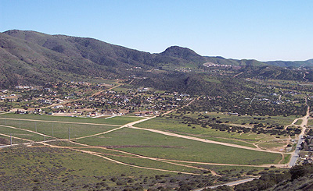
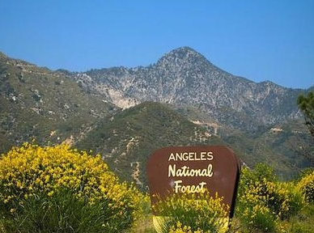
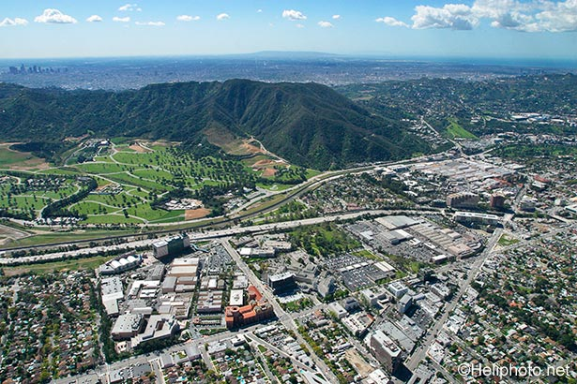
KEY AVOIDANCE & MINIMIZATION ACCOMPLISHMENTS
Palmdale – Uses the Metrolink ROW to the extent possible and grade separates all major at grade roadway crossings of the active rail corridor that exist today
Acton – Avoids historic and cultural resources. Is not closer to the High School than the SR 14 freeway is today
Agua Dulce – Avoids impacts to Vasquez Rocks
Soledad Canyon – Avoids most of Soledad Canyon and crosses the Santa Clara River with a shorter bridge than previous alignments
Santa Clarita – Is underground within the City of Santa Clarita (Entirely underground in a tunnel approximately 400 feet deep)
Sylmar – Is underground within the Sylmar community
San Fernando – Avoids the City of San Fernando completely
Pacoima – Avoids most of Pacoima by traveling underground and then using the Metrolink ROW to the maximum extent possible to avoid introducing a new transportation corridor through this community
Sun Valley – Uses the Metrolink ROW to the maximum extent possible to avoid introducing a new transportation corridor through this community
Lakeview Terrace, Shadow Hills, Sunland/Tujunga – Avoids foothill equestrian communities completely

Slide 13
Shared Urban Corridor
BURBANK TO LOS ANGELES Los Angeles to Anaheim PROJECT SECTIONS

Slide 14
SOUTHERN CALIFORNIA: Shared Urban Rail Corridor
Vital to supporting statewide and regional mobility and goods movement
Supports nation’s second busiest passenger rail line
Facilitates cargo movements to/from two of the busiest ports in the World
Current and future operators/owners are partnering to develop sensible approaches
Safety and state of good repair
Efficiency and reliability of existing rail services
Reducing operating costs
Introducing future high-speed rail service
Unlocking full potential of urban corridor network
Strengthens mobility
Yields economic growth for entire region
Improves air quality/reduces greenhouse gas emissions
Includes projects that ultimately span the entire region
Full HSR Phase 1 system will carry an estimated 40 million riders annually by 2040
SHARED CORRIDOR
Notes:
100+ meetings since Spring 2014

Slide 15
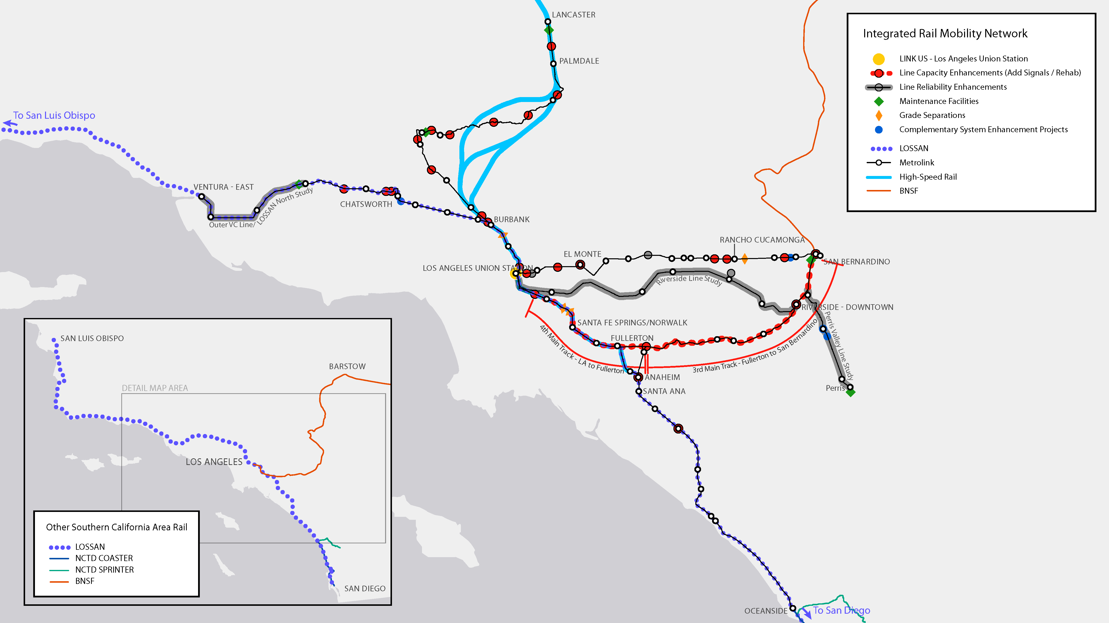
COMPLEMENTARY PLANNING SUPPORTS MOBILITY ENHANCEMENTS ACROSS ENTIRE REGION

Slide 16
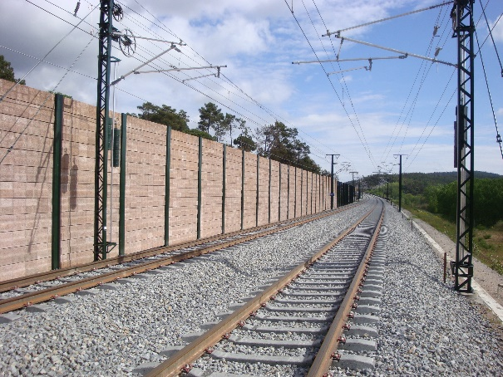
Shared Corridor FEATURES
Corridor Protection/Detection
Fencing
Walls
Soundwalls
Positive Train Control
Restricts speed limits and serves as fail safe system
Takes over system preventing running red signals
Early Earthquake Warning System
Detects initial wave produced by a seismic event
Immediately cuts off power to trains
New and/or Shared Stations
Catalyst for housing/development
Maintenance Facilities
New skilled jobs
Early Earthquake Warning
Corridor Protection
Soundwall Example

Slide 17
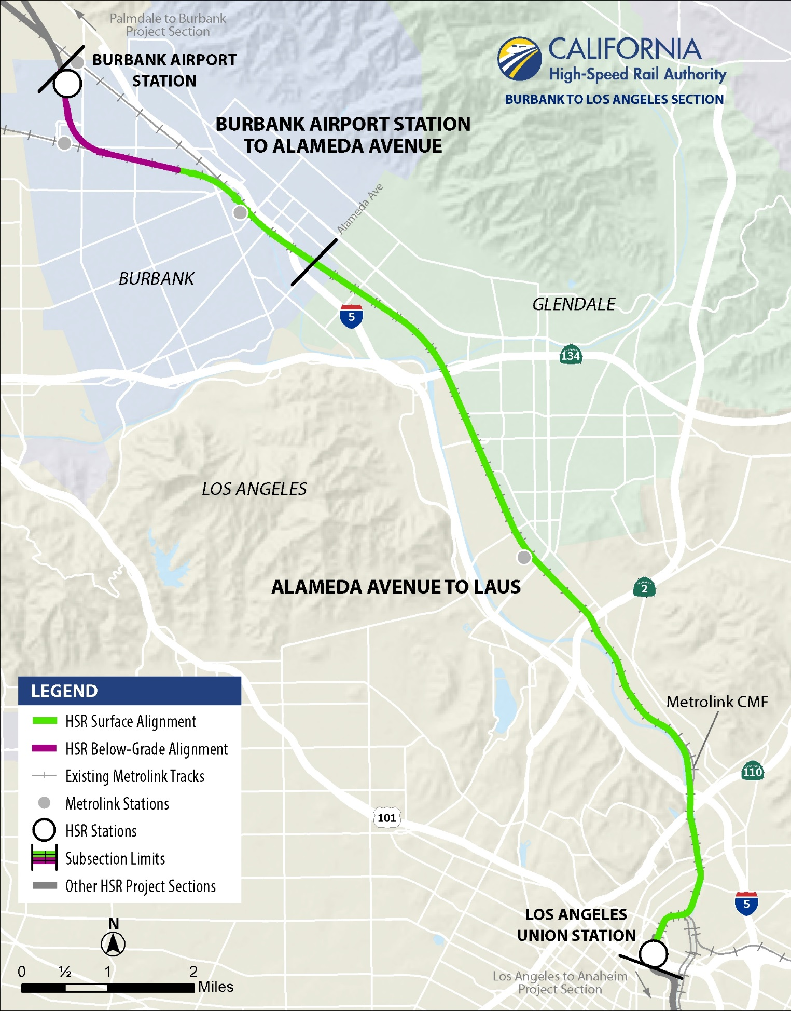
Burbank to Los Angeles
Approximately 14 miles
Two Stations
Burbank Airport Station below-ground
Los Angeles Union Station at-grade
Trackwork
Below-ground portion outside rail corridor near Hollywood Burbank Airport
At-grade throughout remainder of corridor
Shared corridor with LOSSAN, Metrolink, Amtrak, and UPRR
Shift existing tracks to north/east for freight movement
Add two new electrified tracks on south/west to share with passenger rail
Corridor Changes
6 new grade separations (3 elevated)*
Upgraded corridor protection via fencing
2 new bridges over LA River
* Some grade separations could be completed prior to HSR operations as independent early investment projects.

Slide 18
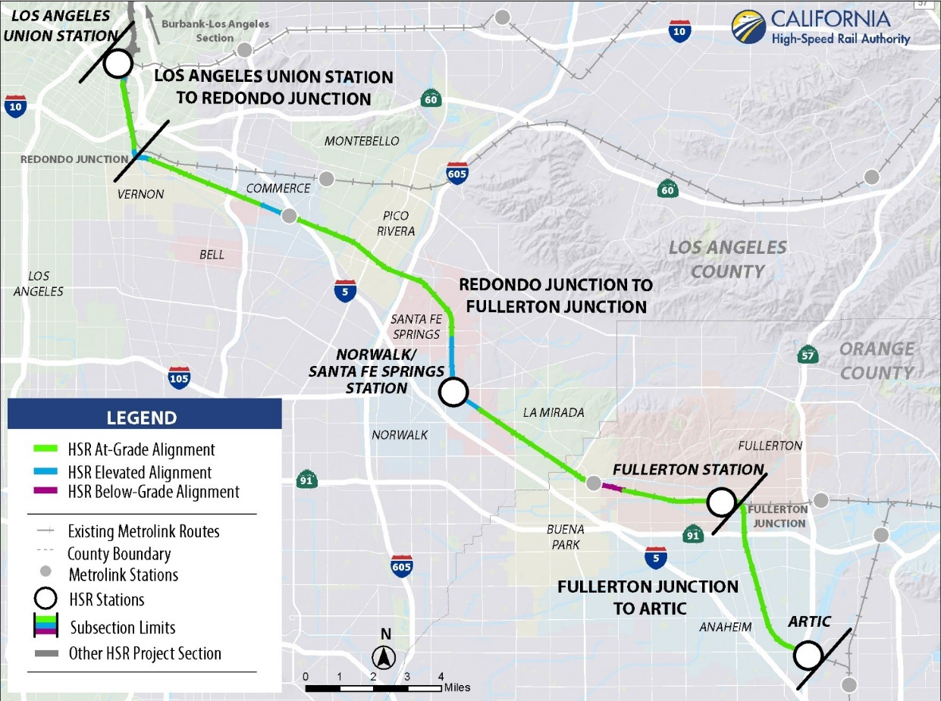
LOS ANGELES TO ANAHEIM
Approximately 30 miles
Four Stations and/or Stops
Los Angeles Union Station
Norwalk/Santa Fe Springs Station
Fullerton Transportation Center
Anaheim Regional Transportation Intermodal Center (ARTIC)
Two Alternatives Under Study
Project Alternative
No Project Alternative
Alternative Evaluated Across Multiple Areas
Improve operational characteristics for passenger and freight services
Freight rail improvements
Improve safety
Complete grade separations
Reduce emissions and congestion
* Some grade separations could be completed prior to HSR operations as independent early investment projects.
Notes:
100+ meetings since Spring 2014

Slide 19
Project development / route selection process

Slide 20
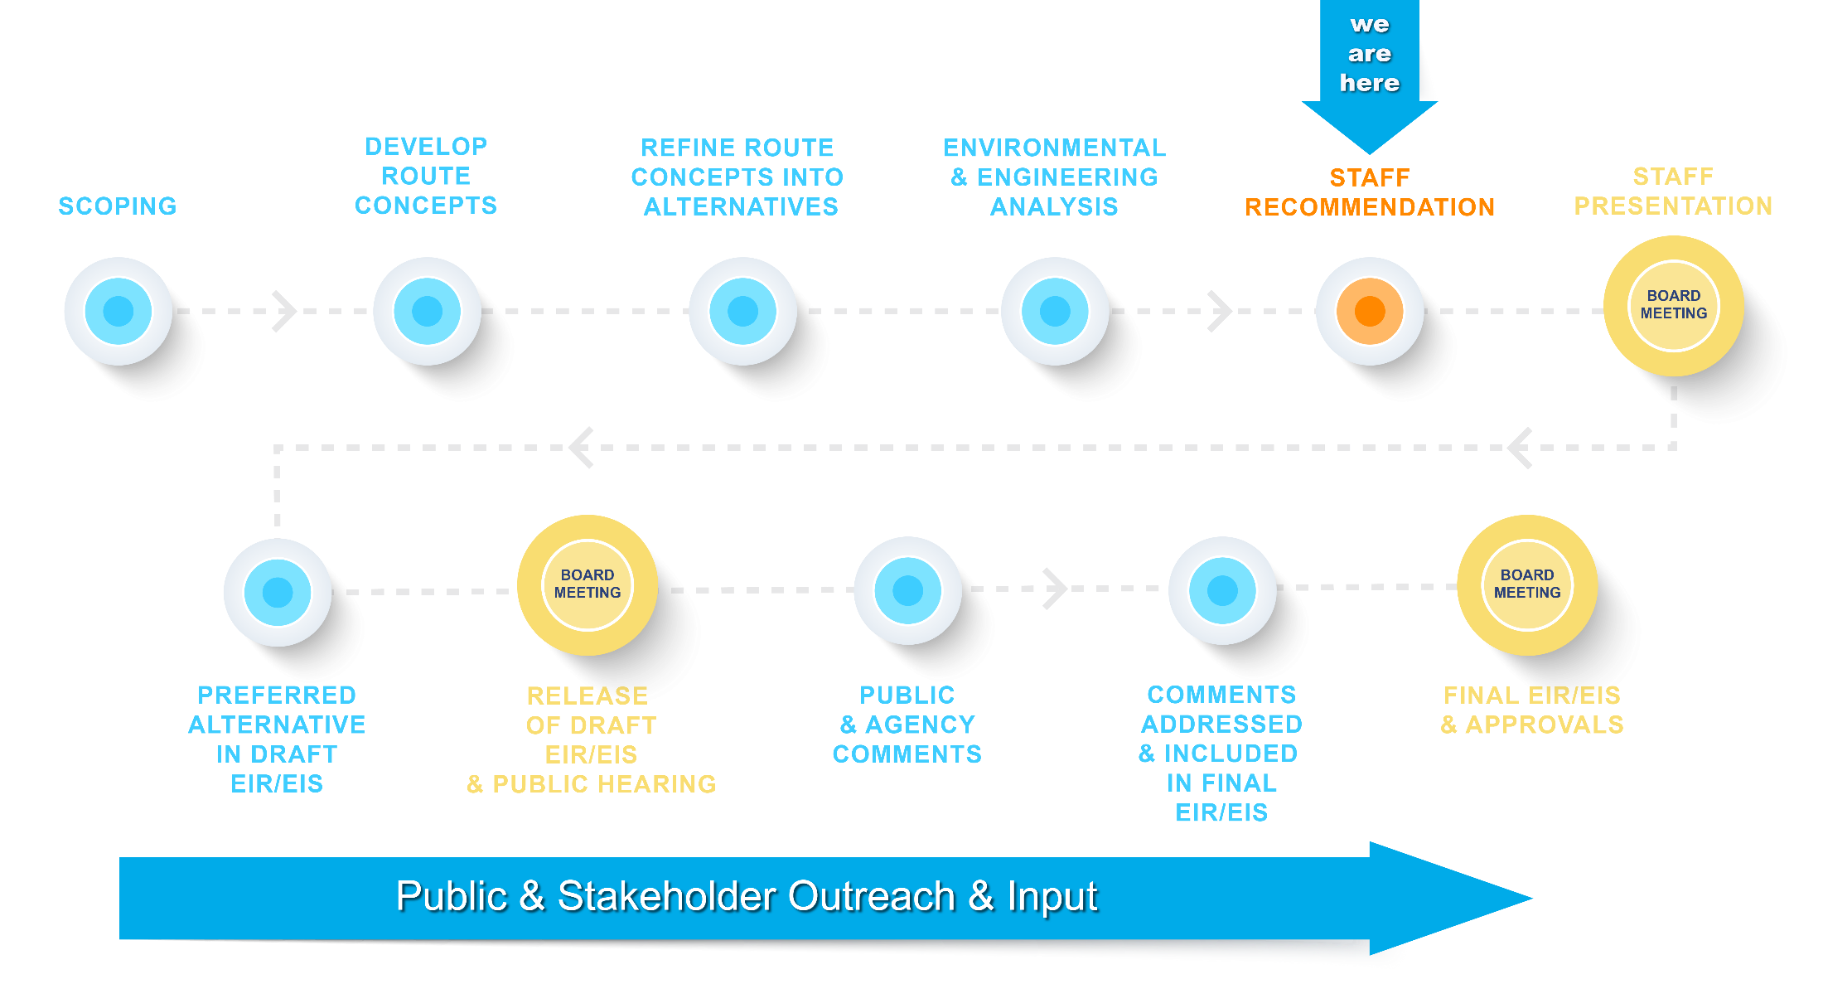
Project Development Process
Notes:
This flow chart shows the process the Authority is following to conduct route selection and environmental clearance activities. This has been communicated to you many times over the years to help understand the significant work that is done to support route selection.
As you can see, we have already completed several steps along the way toward the ultimate identification of the route the Palmdale to Burbank Section will follow.
Today, we are here to communicate to the public the route the staff plans to recommend to our board later this fall as the State’s Preferred Alternative.
Based upon our comprehensive analysis to date, multiple consultations with agencies, project partners and the public, we have information that suggests that one of the three alternatives currently under study is a candidate to be identified as the State’s Preferred Alternative, pending direction from the Authority’s Board of Directors. Since we have this information today we want to present it to you.
This does NOT mean that this alterative, as defined today, will be identified as the final project for Palmdale to Burbank. We still have several steps to complete before we certify the final project for this project section, as you can see on the flow chart on your screen.
Letting the public know today is consistent with our goal to always bring the latest information to the public, obtain feedback from the public and inform our Board what we learn from the public.
The public can then prepare comments to the board that reflect the best information available to date on the project which in turn helps the Board develop informed feedback on information presented to them.
At this Board meeting the public will have the opportunity to address the Board directly about the project after having already been informed about it through our meetings and noticing.
This meeting will be held in the San Fernando Valley consistent with the discussions between the Authority, the Board, local officials and the public over the past several years.
Following staffs’ presentation, the Board will then provide direction on the recommendation that was presented leading to the adoption of the state preferred alternative
Following adoption of the state’s preferred alternative, the Draft EIS/EIR will be prepared for release and public review and comment.
Following public comment on the DEIR/S the Authority will begin preparing a Final EIS/EIR. Ultimately, the final decision to define the project is marked by the certification/approval of the final environmental documents which is currently still over two years away.

Slide 21
AVOIDING, MINIMIZING & MITIGATING POTENTIAL IMPACTS
Authority strives to:
1. Avoid adverse impacts
2. Minimize impacts, when they cannot be avoided
3. Mitigate impacts, when they cannot be avoided or minimized
Ongoing during Planning & Design
Based on community & stakeholder feedback
Ongoing agency coordination
Avoid
Minimize
Mitigate

Slide 22
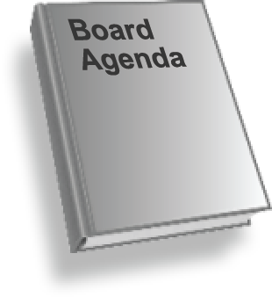
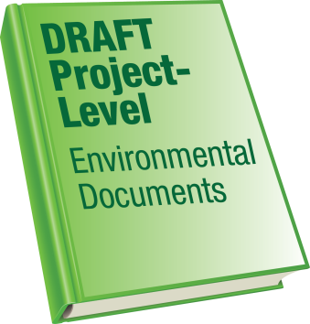
Steps Toward Release of Draft EIR/EIS
High-Speed Rail Purpose and Need
“…provide the public with electric-powered high-speed rail service that offers predictable and consistent travel times between major urban centers…”
Federal NEPA processes encourage federal and state agencies to identify a Preferred Alternative before the release of the Draft Environmental Documents
Staff recommends an alternative to the Board for their consideration prior to the release of the Draft EIR/EIS
The Board will then direct the staff on how to proceed
Staff is scheduled to present a recommendation to the Board this Fall
After receiving direction from the Board, staff will prepare the Draft EIR/EIS for release
Notes:
WHY A PREFERRED ALTERNATIVE?
Prior to my sharing with you our staff’s recommendation for the Preferred Alternative, I would like to review this process.
The Authority has adopted this process in order to conduct our work in an open and collaborative manner.
Not every environmental document is conducted using this sequence of activities, but by using this sequence we are able to provide the public a heads up about what we know about our project alternatives and which alternative is rising to the top as representing the best balance.
The federal department of transportation encourages federal and state agencies to identify a Preferred Alternative BEFORE the release of the Draft Environmental Document for the reasons discussed above.
Staff identify this alternative and present it to the public and our board as the best candidate to be designated the State’s Preferred Alternative
The board then provides direction to staff about this recommended approach which is then used to prepare and release the Draft Environmental Document.
Staff will make this presentation to the Board November 15, 2018.
As has been requested by the community, this meeting will be in the SFV, in a location yet to be determined.
At this meeting the public can address the board and provide their perspective about the alternative prior to the staff presentation.
The staff will then present the rationale for selecting the Preferred Alternative, and the board can then direct staff to move forward with the project as described or provide other direction to the staff for completion of the Draft Environmental Document.

Slide 23
Next steps

Slide 24
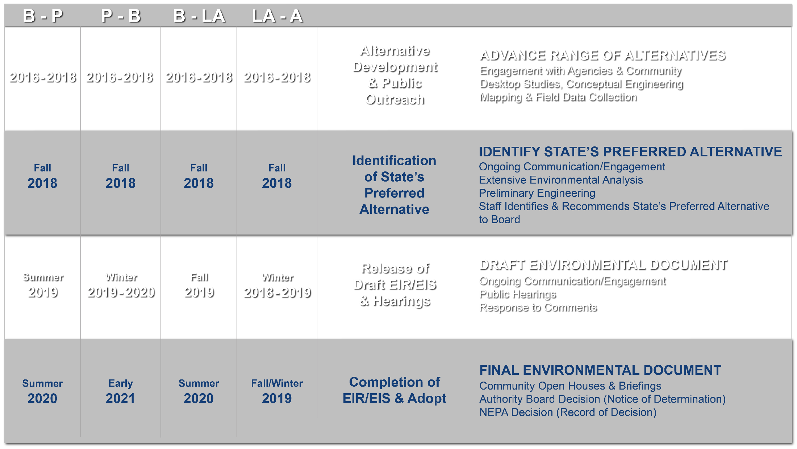
PROJECT TIMELINES *
*Subject to Change

Slide 25
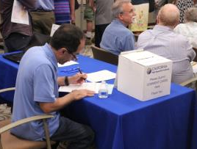
Stay involved
Bakersfield to Palmdale Project Section
(866) 300-3044
bakersfield_palmdale@hsr.ca.gov
Palmdale to Burbank Project Section
(800) 630-1039
palmdale_burbank@hsr.ca.gov
Burbank to Los Angeles Project Section
(877) 977-1660
burbank_los.angeles@hsr.ca.gov
Los Angeles to Anaheim Project Section
(877) 669-0494
los.angeles_anaheim@hsr.ca.gov
@cahsra
facebook.com/CaliforniaHighSpeedRail
@cahsra
youtube.com/CAHighSpeedRail
Southern California Regional Office California High-Speed Rail Authority 355 S Grand Ave, Suite 2050 Los Angeles CA 90071
www.hsr.ca.gov

